Slide 1


USD Swaption, Interest Rate Model and Calibration
Presented by Bryan Lin, Sean Wang, Jessie Xu, Peter Kim
On behalf of Mizuho Securities. USA

Slide 2
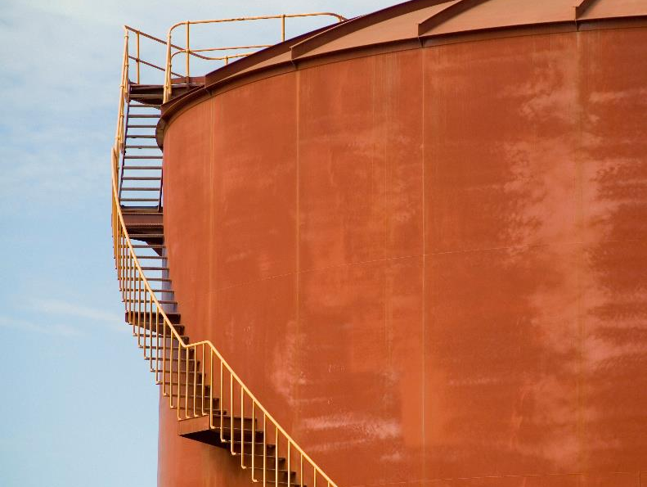
Contents
Part I: Background
Part II: USD Swaption
Part III: Interest Rate Models
Part IV: Model Calibration
Part V: Result
Part VI: Conclusion
Appendix

Slide 3

Part I: Background
Purpose of what we are doing…
Post-2008, meticulous focus on evaluating counterparty risk, Credit Value Adjustment (CVA)
Mizuho Securities USA trades USD swaption in the OTC market
Demand for better model of pricing and risk management (e.g. volatility)
* Note: CVA is not in the scope of the project

Slide 4
Part I: Background
The USD swaption market comprises 5.6% of the $564.7T interest rate swap market (24.9% of uncleared market)
Market Details | Key Characteristics
(CBOE) Interest Rate Swaption Volatility | Relevant parameters (e.g. tenor, strike price, skews) across popular global currencies Option tenors (1 mo. to 30 yrs.) Swap tenors (1 yr. to 20 yrs.)
(CME) Cleared Swaption Offering | Product scope: USD-denominated European-style exercise Maximum 2-year option expiry Maximum underlying swap tenor of 30 years
USD Swaption Market | As shown above, USD interest rate volatility is implied by swaption prices Compensation for volatility risk has been higher in the U.S. compared to Europe Valuation requires careful calibration of the interest rate forecast model (Hull-White/G2++)

Slide 5
Part II: USD Swaption
Swaption is an option to enter into a type of underlying swap …
Tenor
Terms of the underlying swap buyers opt to exercise and take position
Maturity
Maturity of the option; either to exercise or not
Type
European, American or Bermudan
Counter-party
Payer or receiver of the swap once exercised

Slide 6
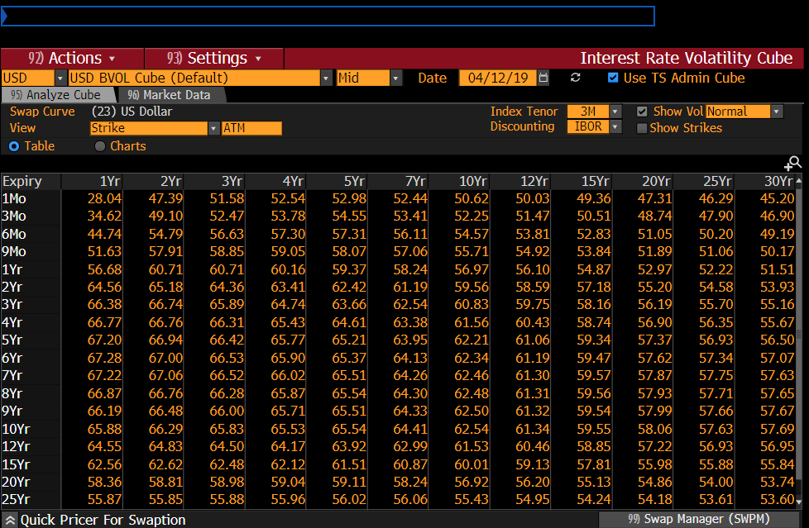
Part II: USD Swaption
Example swaption quotes (volatility) from Bloomberg

Slide 7

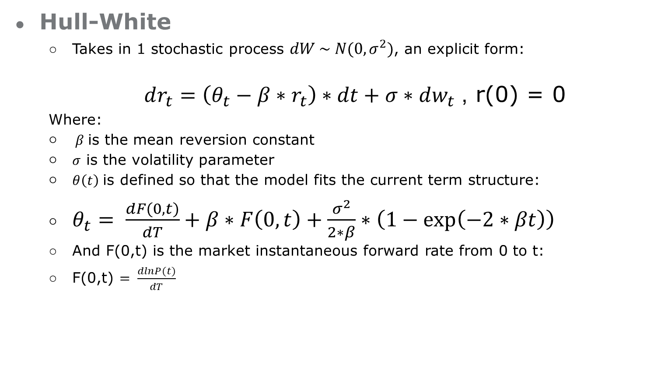
Part III: Interest Rate Model
Hull-White
Takes in 1 stochastic process $dW \sim N(0,σ^{2})$, an explicit form:
$dr_{t}=\left(θ_{t}−β∗r_{t}\right)∗dt+σ∗dw_{t}$, r(0) = 0
Where:
$β$ is the mean reversion constant
$σ$ is the volatility parameter
$θ\left(t\right)$ is defined so that the model fits the current term structure:
$θ_{t}= \frac{dF(0,t)}{dT}+β∗F\left(0,t\right)+\frac{σ^{2}}{2∗β}∗\left(1−\exp\left(−2∗βt\right)\right)$
And F(0,t) is the market instantaneous forward rate from 0 to t:
F(0,t) $= \frac{dlnP(t)}{dT}$

Slide 8

Part III: Interest Rate Model
Hull-White Closed-Form:
Under this model, the price of a payer swaption is:
$$N\sum_{i=0}^{n}{\left(1+K∗δt\right)∗ZCB(t,T,T_{i},K_{i})}$$
Where
$$ZCB\left(t,T,T_{i},K_{i}\right)=KP_{ZC}\left(t,T\right)∗θ\left(−d∗σ\right)−P_{ZC}\left(t,S\right)∗θ(−d)$$

Slide 9

Part III: Interest Rate Model
Hull-White Summary
Pros
Simple and widely used
1 stochastic process dZ
Closed form solutions
Cons
Constraint in fitting volatility surface
Negative value may occur
May not resemble yield curve perfectly

Slide 10
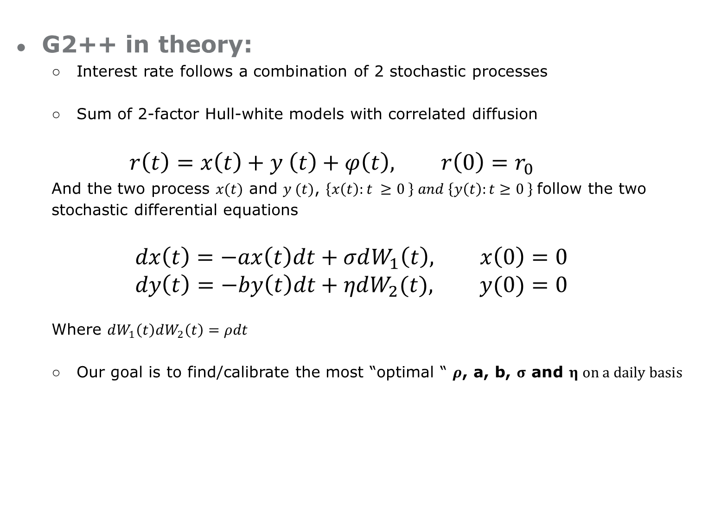
Part III: Interest Rate Model
G2++ in theory:
Interest rate follows a combination of 2 stochastic processes
Sum of 2-factor Hull-white models with correlated diffusion
$$r\left(t\right)=x\left(t\right)+y \left(t\right)+φ\left(t\right), r\left(0\right)=r_{0}$$
And the two process $x(t)$ and $y (t)$, $\left\{x\left(t\right):t ≥0 \right\} and \left\{y\left(t\right):t≥0 \right\}$follow the two stochastic differential equations
$$dx\left(t\right)=−ax\left(t\right)dt+σdW_{1}\left(t\right), x\left(0\right)=0 \\ dy\left(t\right)=−by\left(t\right)dt+ηdW_{2}(t), y(0)=0$$
Where $dW_{1}\left(t\right)dW_{2}\left(t\right)=ρdt$
Our goal is to find/calibrate the most “optimal “ $ρ$, a, b, $σ$ and $η on a daily basis$

Slide 11
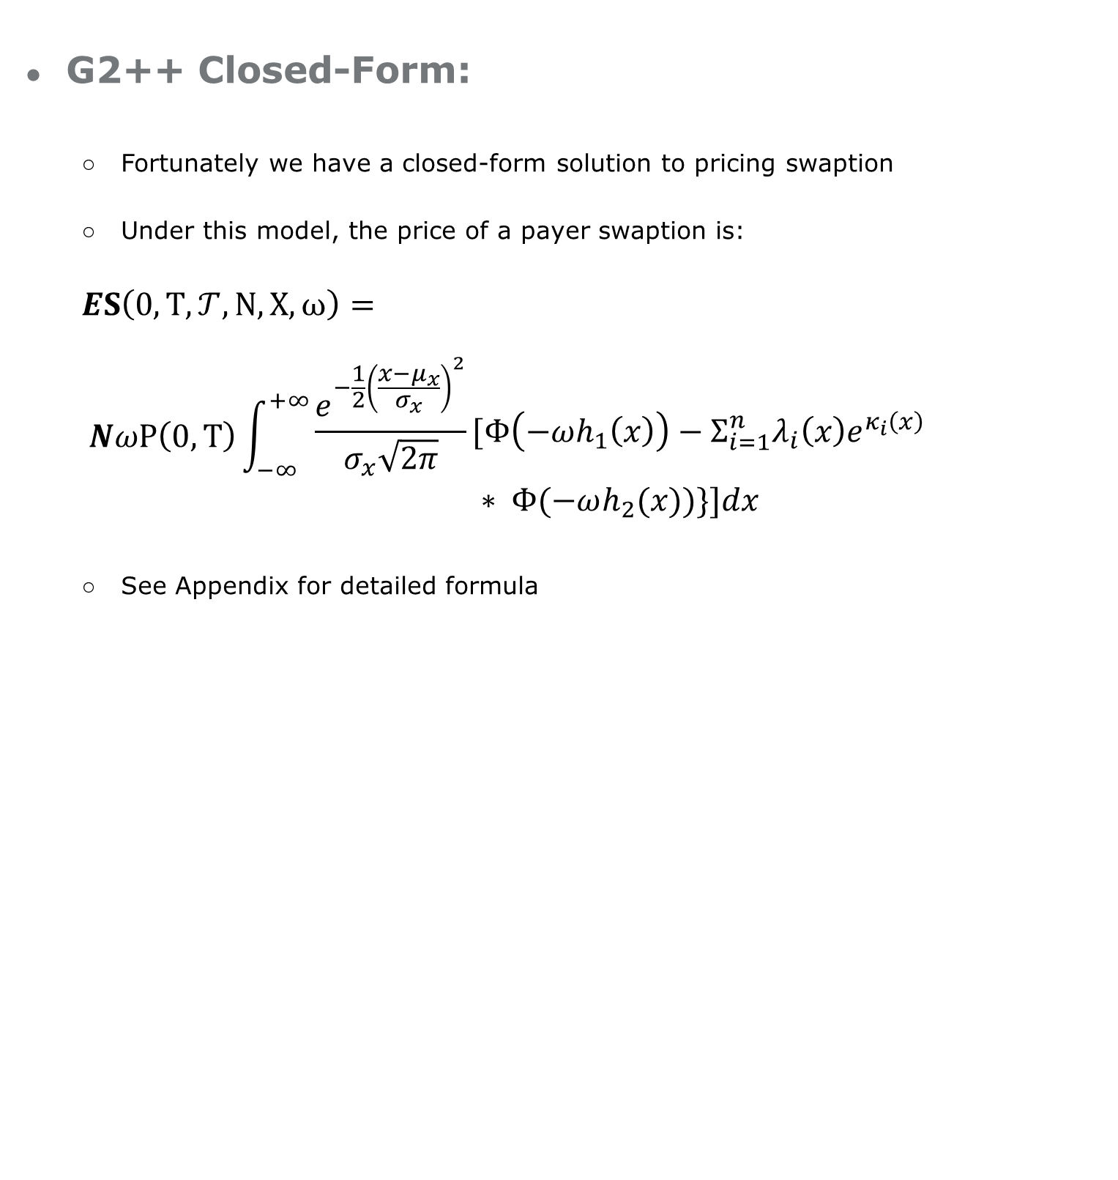
Part III: Interest Rate Model
G2++ Closed-Form:
Fortunately we have a closed-form solution to pricing swaption
Under this model, the price of a payer swaption is:
$$ES\left(0, T, 𝒯, N,X, ω\right)=$$
$$NωP\left(0,T\right)\int_{−∞ }^{+∞}{\begin{aligned}\frac{e^{−\frac{1}{2}{\left(\frac{x−μ_{x}}{σ_{x}}\right)}^{2}}}{σ_{x}\sqrt{2π}}[Φ\left(−ωh_{1}\left(x\right)\right)−Σ_{i=1}^{n}λ_{i}\left(x\right)e^{κ_{i}\left(x\right)} \\ ∗ Φ(−ωh_{2}(x))\}]dx\end{aligned}}$$
See Appendix for detailed formula

Slide 12
Part III: Interest Rate Model
G2++ Closed-Form :
Ugly formula, we know… but take it for granted, AND
Given the closed-form solution, not so hard to price any kind of European swaptions, once we know all model parameters
However, in reality we know none of them…
Need model calibration to figure out what those numbers are --- Backout!!!

Slide 13
Part III: Interest Rate Model
G2++ Summary
Pros
Generally a sum of 2-factor Hull-White models
Flexible in fitting different volatility surface
Non-perfect correlation between maturities
Cons
Mathematically hard to solve
Model parameters may not have economic meanings
Time consuming ~2hr

Slide 14
Calibration Methodology – Defining the input
Part IV: Model Calibration
Choice of benchmark model
Normal/Bachelier Swaption Pricing Model (Available on Bloomberg)
Normal Model is getting more standard than Black Model because of the need to deal with negative yield environment
Choice of discounting method
OIS (overnight indexed swap) USD yield curve (Available on Bloomberg): a convention after 2008 where LIBOR is no longer seen as risk free rate
Linear Interpolation on the zero curve.

Slide 15
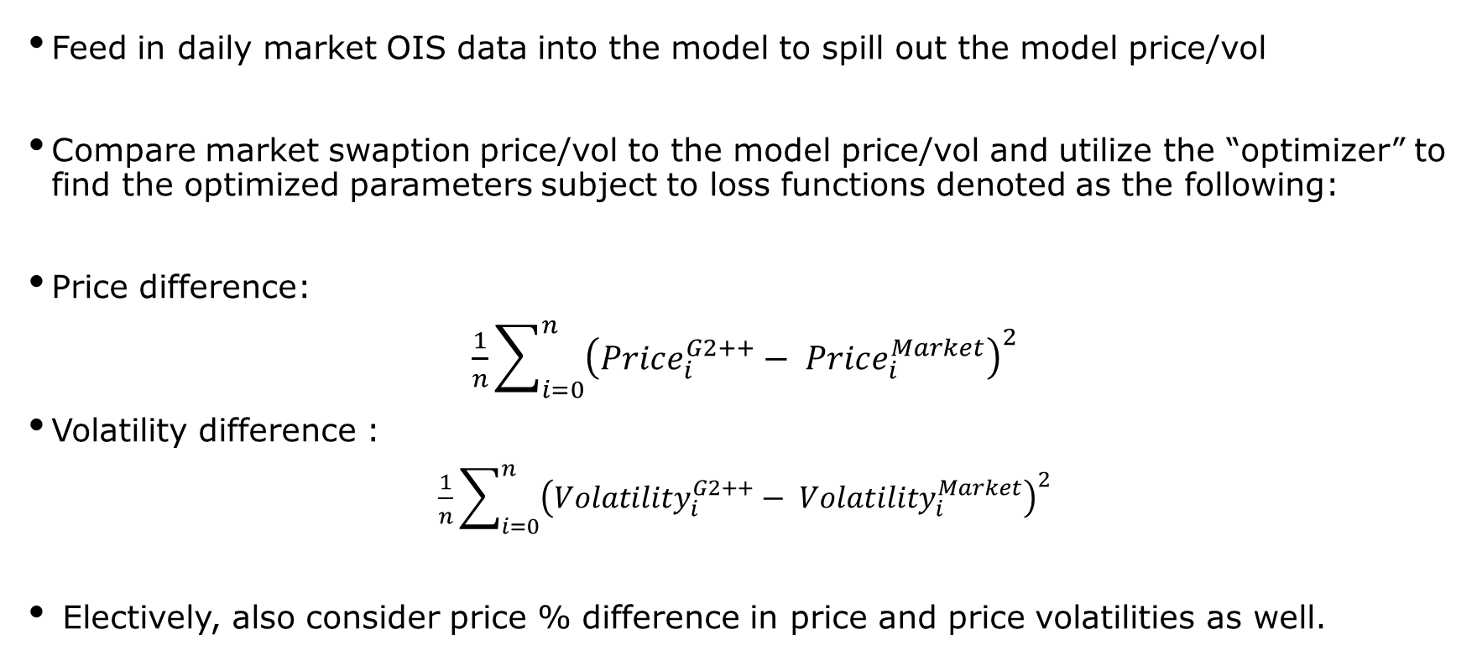
Calibration Methodology – Choice of Loss Function
Part IV: Model Calibration
Feed in daily market OIS data into the model to spill out the model price/vol
Compare market swaption price/vol to the model price/vol and utilize the “optimizer” to find the optimized parameters subject to loss functions denoted as the following:
Price difference:
$\frac{1}{n}\sum_{i=0}^{n}{{\left(Price_{i}^{G2++}− Price_{i}^{Market}\right)}^{2}}$
Volatility difference :
$\frac{1}{n}\sum_{i=0}^{n}{{\left({Volatility}_{i}^{G2++}− {Volatility}_{i}^{Market}\right)}^{2}}$
Electively, also consider price % difference in price and price volatilities as well.

Slide 16
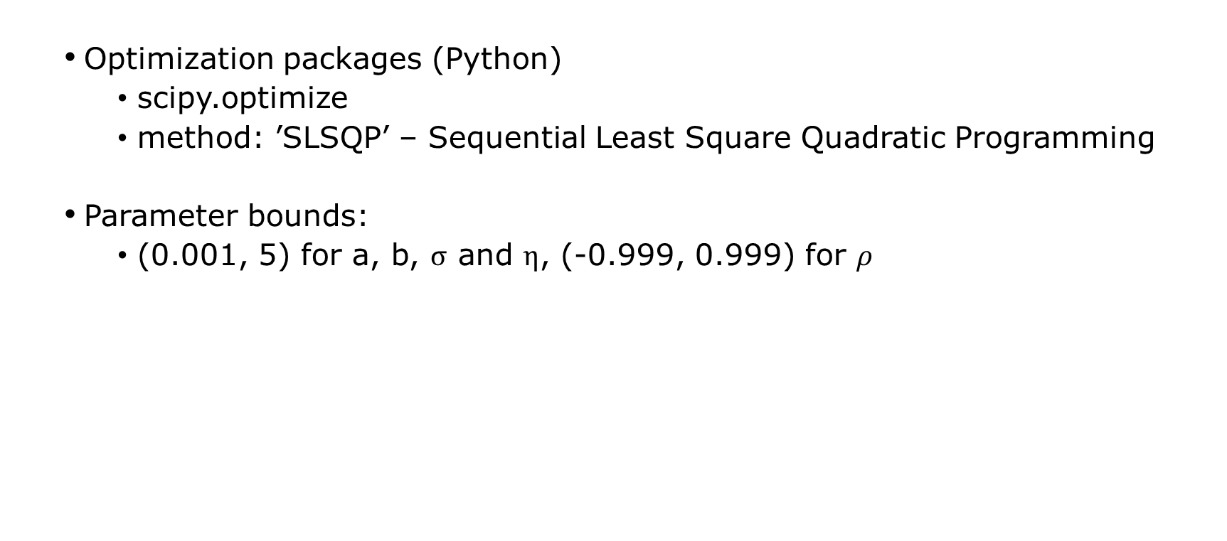
Calibration Methodology – Optimisation
Part IV: Model Calibration
Optimization packages (Python)
﻿scipy.optimize
﻿method: ’SLSQP’ – Sequential Least Square Quadratic Programming
Parameter bounds:
﻿(0.001, 5) for a, b, $σ$ and $η$, (-0.999, 0.999) for $ρ$

Slide 17
Calibration Methodology – Building the pricing engine and Calibration Tool
Part IV: Model Calibration
G2++ Price Engine
Initial Model Parameters
Loss Function
Closed-Form Solution Price
Model Implied Volatility
Mean Squared Error
Interpolation
Optimizer
OIS Yield Curve
Construct Zero Curve
Boundary Condition
Market Vol Surface
Construct Forward Curve
Non-linear Solver
Optimal parameters

Slide 18


Part V: Calibration Result

Slide 19
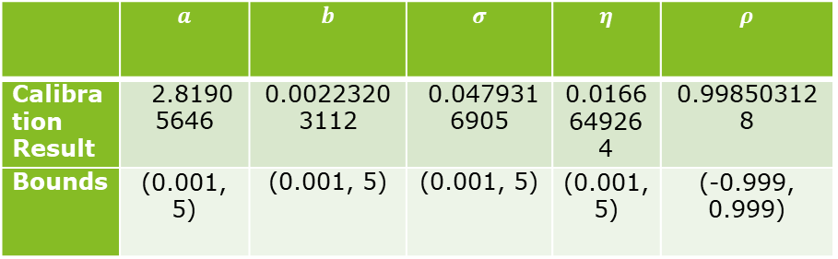
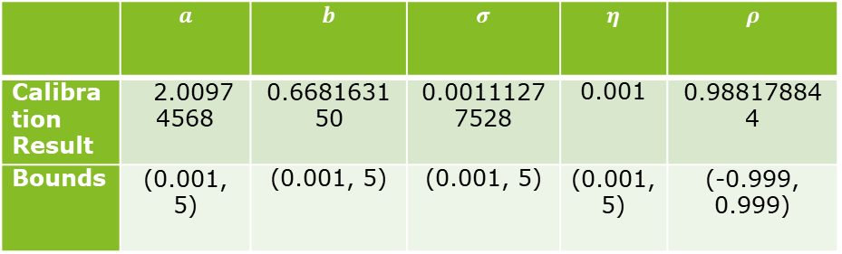
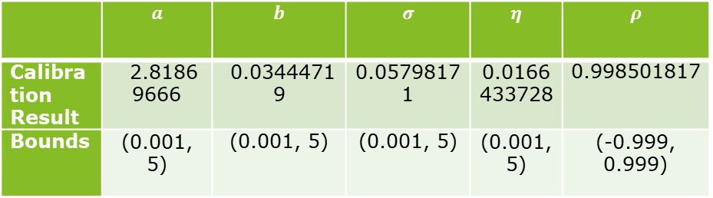
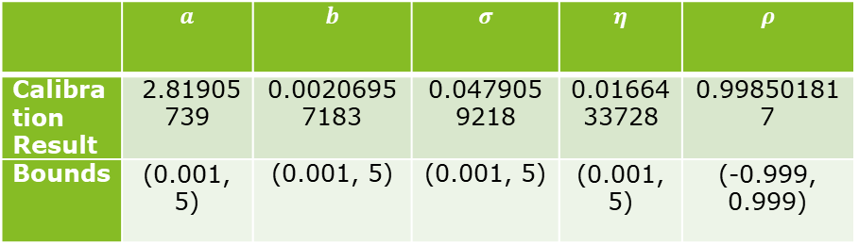
Part V: Result
Loss Function as: Price $/% Difference
Loss Function as: Vol bps/% Difference
 | $$a$$ | $$b$$ | $$σ$$ | $$η$$ | $$ρ$$
Calibration Result | ﻿ ﻿2.81905739 | ﻿0.00206957183 | ﻿0.0479059218 | ﻿0.0166433728 | ﻿0.998501817
Bounds | (0.001, 5) | (0.001, 5) | (0.001, 5) | (0.001, 5) | (-0.999, 0.999)
 | $$a$$ | $$b$$ | $$σ$$ | $$η$$ | $$ρ$$
Calibration Result | ﻿ ﻿ ﻿2.81869666 | ﻿ ﻿0.03444719 | 0.05798171 | ﻿0.0166433728 | ﻿0.998501817
Bounds | (0.001, 5) | (0.001, 5) | (0.001, 5) | (0.001, 5) | (-0.999, 0.999)
 | $$a$$ | $$b$$ | $$σ$$ | $$η$$ | $$ρ$$
Calibration Result | ﻿ ﻿ ﻿2.81905646 | ﻿0.00223203112 | ﻿ ﻿0.0479316905 | ﻿﻿0.0166649264 | ﻿﻿0.998503128
Bounds | (0.001, 5) | (0.001, 5) | (0.001, 5) | (0.001, 5) | (-0.999, 0.999)
 | $$a$$ | $$b$$ | $$σ$$ | $$η$$ | $$ρ$$
Calibration Result | ﻿ ﻿ ﻿2.00974568 | ﻿﻿0.668163150 | ﻿0.00111277528 | ﻿﻿0.001 | ﻿﻿0.988178844
Bounds | (0.001, 5) | (0.001, 5) | (0.001, 5) | (0.001, 5) | (-0.999, 0.999)

Slide 20
Part V: Result
Loss Function as: Price Difference

Slide 21
Part V: Result
Loss Function as: Percentage Price Difference

Slide 22
Part V: Result
Loss Function as: Volatility Difference

Slide 23
Part V: Result
Loss Function as: Percentage Volatility Difference

Slide 24
Part V: Result
Loss Function as: Price Percentage Difference
The most optimal result calibrated!
Average difference between market vol and model vol is ~0.3bps
In the given sample period, average bid-ask spread of vol cube ~1bps

Slide 25
Part V: Result
Predicting Power？
Loss Function as % Price Difference
Loss Function as Price Difference

Slide 26
Part V: Result
Predicting Power？
Loss Function as Vol Difference
Loss Function as % Vol Difference

Slide 27
Part VI: To Conclude
Build a G2++ swaption pricing and calibration tool in Python.
Calibrated parameters to fit the market.
Price/Price% seems perform better than Vol.
To the full scope of our research, to perform calibration daily.

Slide 28

Thank you!
Any comments?

Slide 29
Appendix
Literature Review:
“Interest Rate Models: Theory and Practice - with Smile, Inflation and Credit” by D. Brigo and F. Mercurio, Springer-Verlag, 2001 (2nd ed. 2006).
“A Comparative Study of the 1-Factor Hull White and The G2++ Interest Rate Model” by Marcus Scheffer , Ph.D, Mario Zacharias, Ph.D, Milliman Research Report.

Slide 30
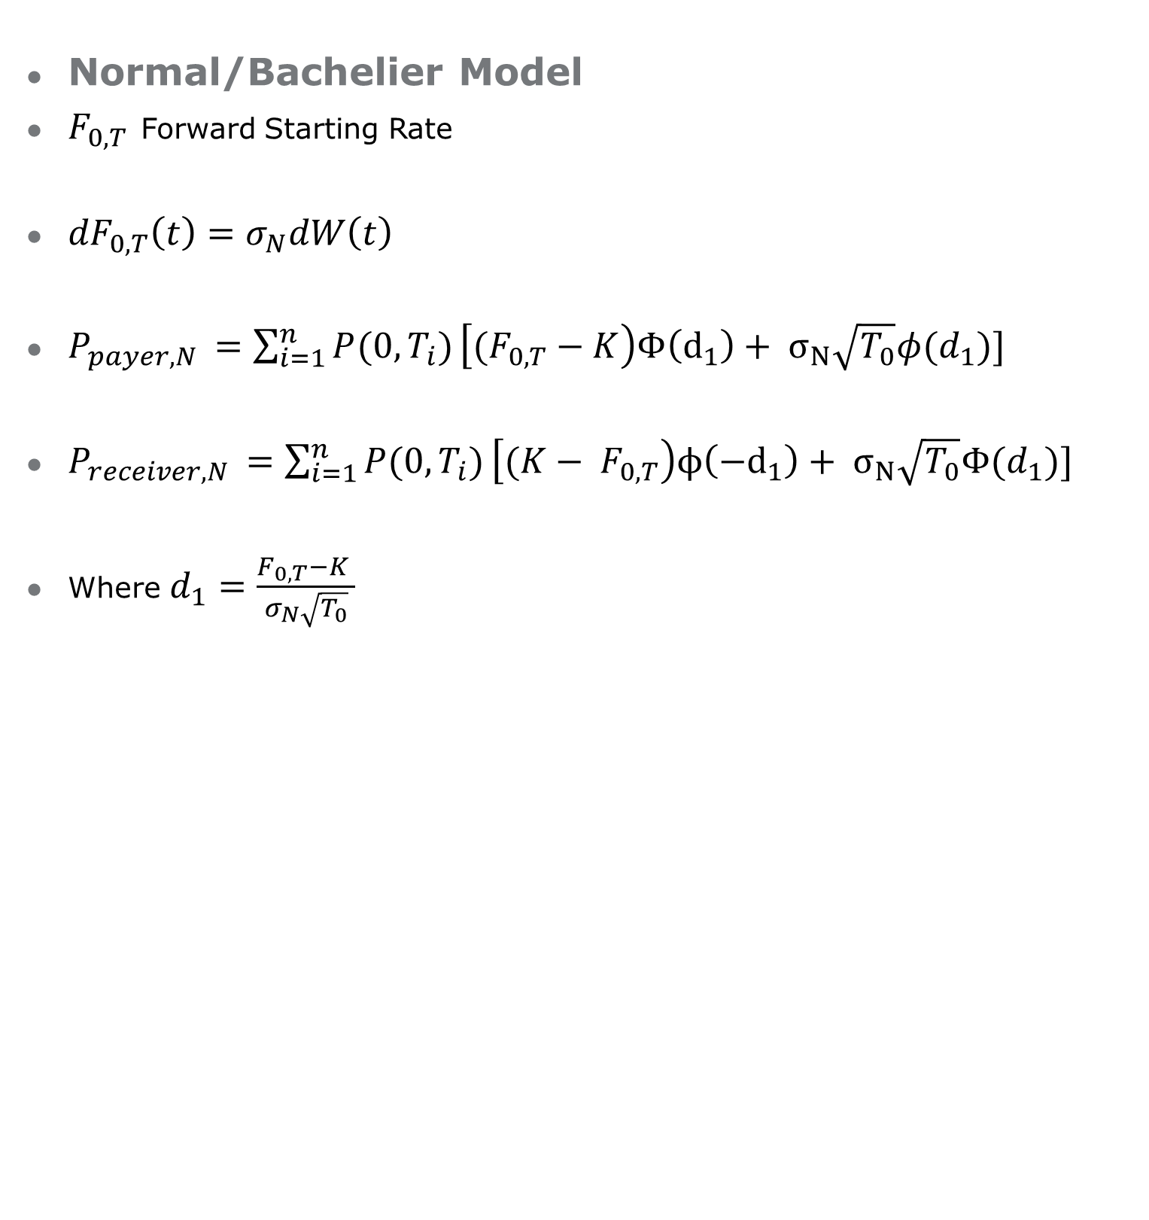
Appendix:
Normal/Bachelier Model
$F_{0,T}$ Forward Starting Rate
${dF}_{0,T}\left(t\right)=σ_{N}dW\left(t\right)$
$P_{payer,N }=\sum_{i=1}^{n}{P(0, T_{i})}\left[(F_{0,T}−K\right)Φ\left(d_{1}\right)+ σ_{N}\sqrt{T_{0}}φ(d_{1})]$
$P_{receiver,N }=\sum_{i=1}^{n}{P(0, T_{i})}\left[(K− F_{0,T}\right)ϕ\left({−d}_{1}\right)+ σ_{N}\sqrt{T_{0}}Φ(d_{1})]$
Where$d_{1}=\frac{F_{0,T}−K }{σ_{N}\sqrt{T_{0}}}$

Slide 31
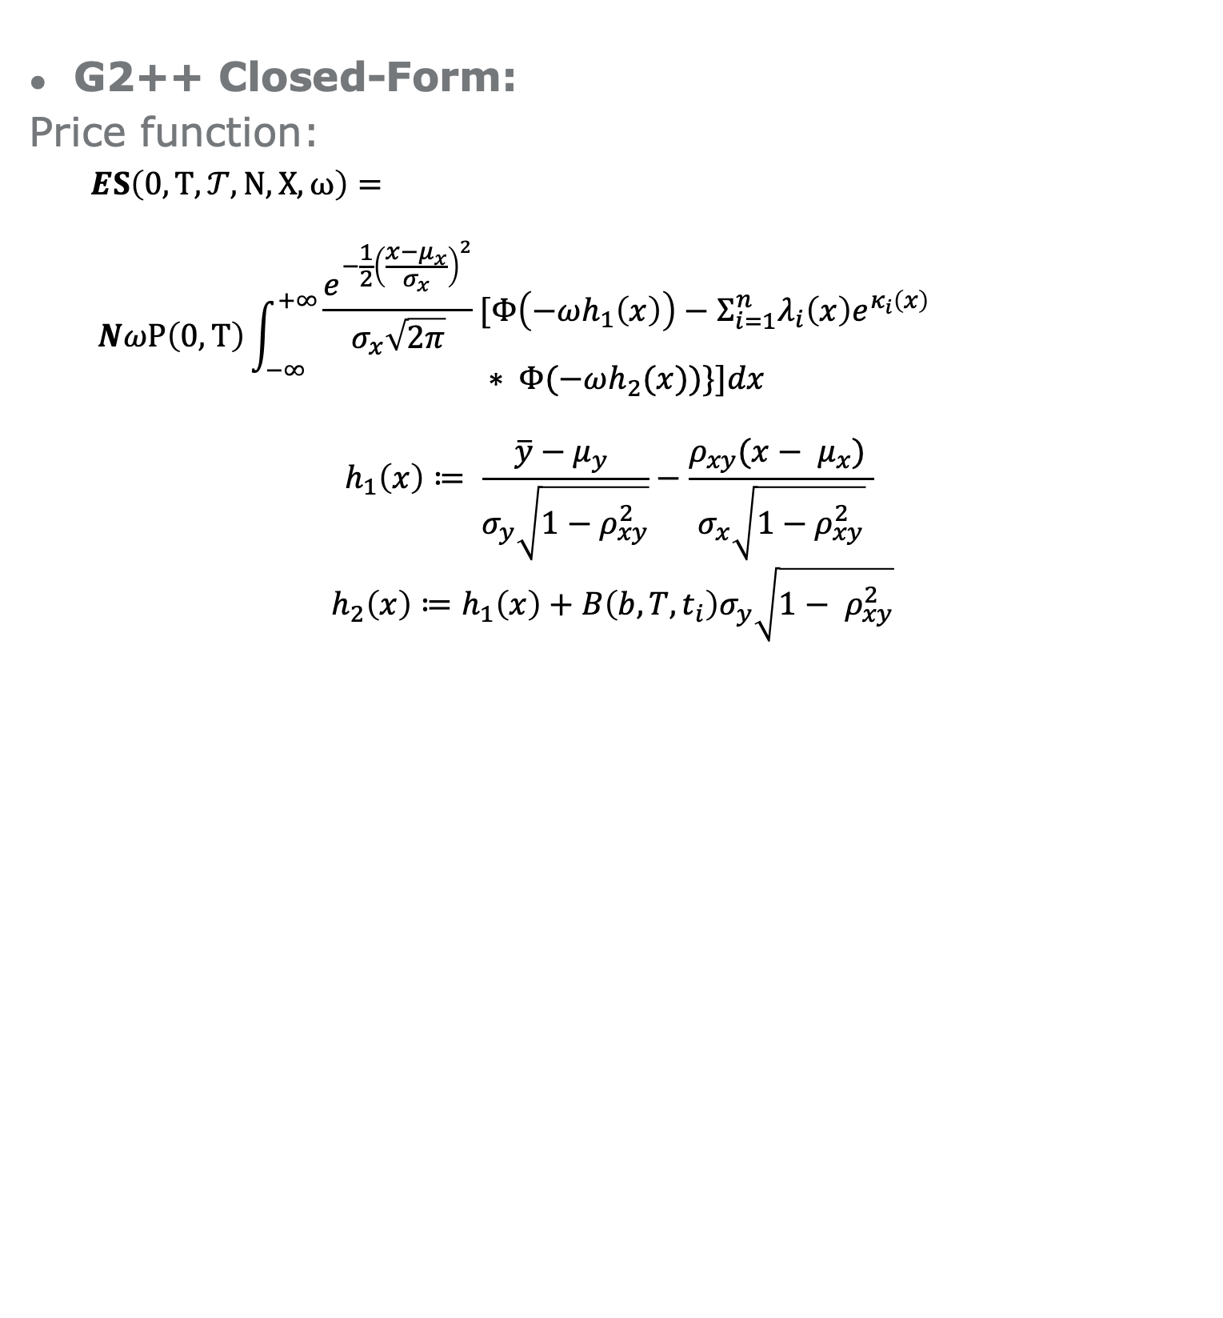
Appendix
G2++ Closed-Form:
Price function:
$$ES\left(0, T, 𝒯, N,X, ω\right)=$$
$$NωP\left(0,T\right)\int_{−∞ }^{+∞}{\begin{aligned}\begin{aligned}\frac{e^{−\frac{1}{2}{\left(\frac{x−μ_{x}}{σ_{x}}\right)}^{2}}}{σ_{x}\sqrt{2π}}[Φ\left(−ωh_{1}\left(x\right)\right)−Σ_{i=1}^{n}λ_{i}\left(x\right)e^{κ_{i}\left(x\right)} \\ ∗ Φ(−ωh_{2}(x))\}]dx\end{aligned} \\ \end{aligned}}$$
$$h_{1}\left(x\right)≔ \frac{\overline{y}−μ_{y} }{σ_{y}\sqrt{1−ρ_{xy}^{2}}}−\frac{ρ_{xy}(x− μ_{x}) }{σ_{x}\sqrt{1−ρ_{xy}^{2}}}$$
$$h_{2}\left(x\right)≔h_{1}\left(x\right)+B\left(b, T,t_{i}\right)σ_{y}\sqrt{1− ρ_{xy}^{2}}$$

Slide 32
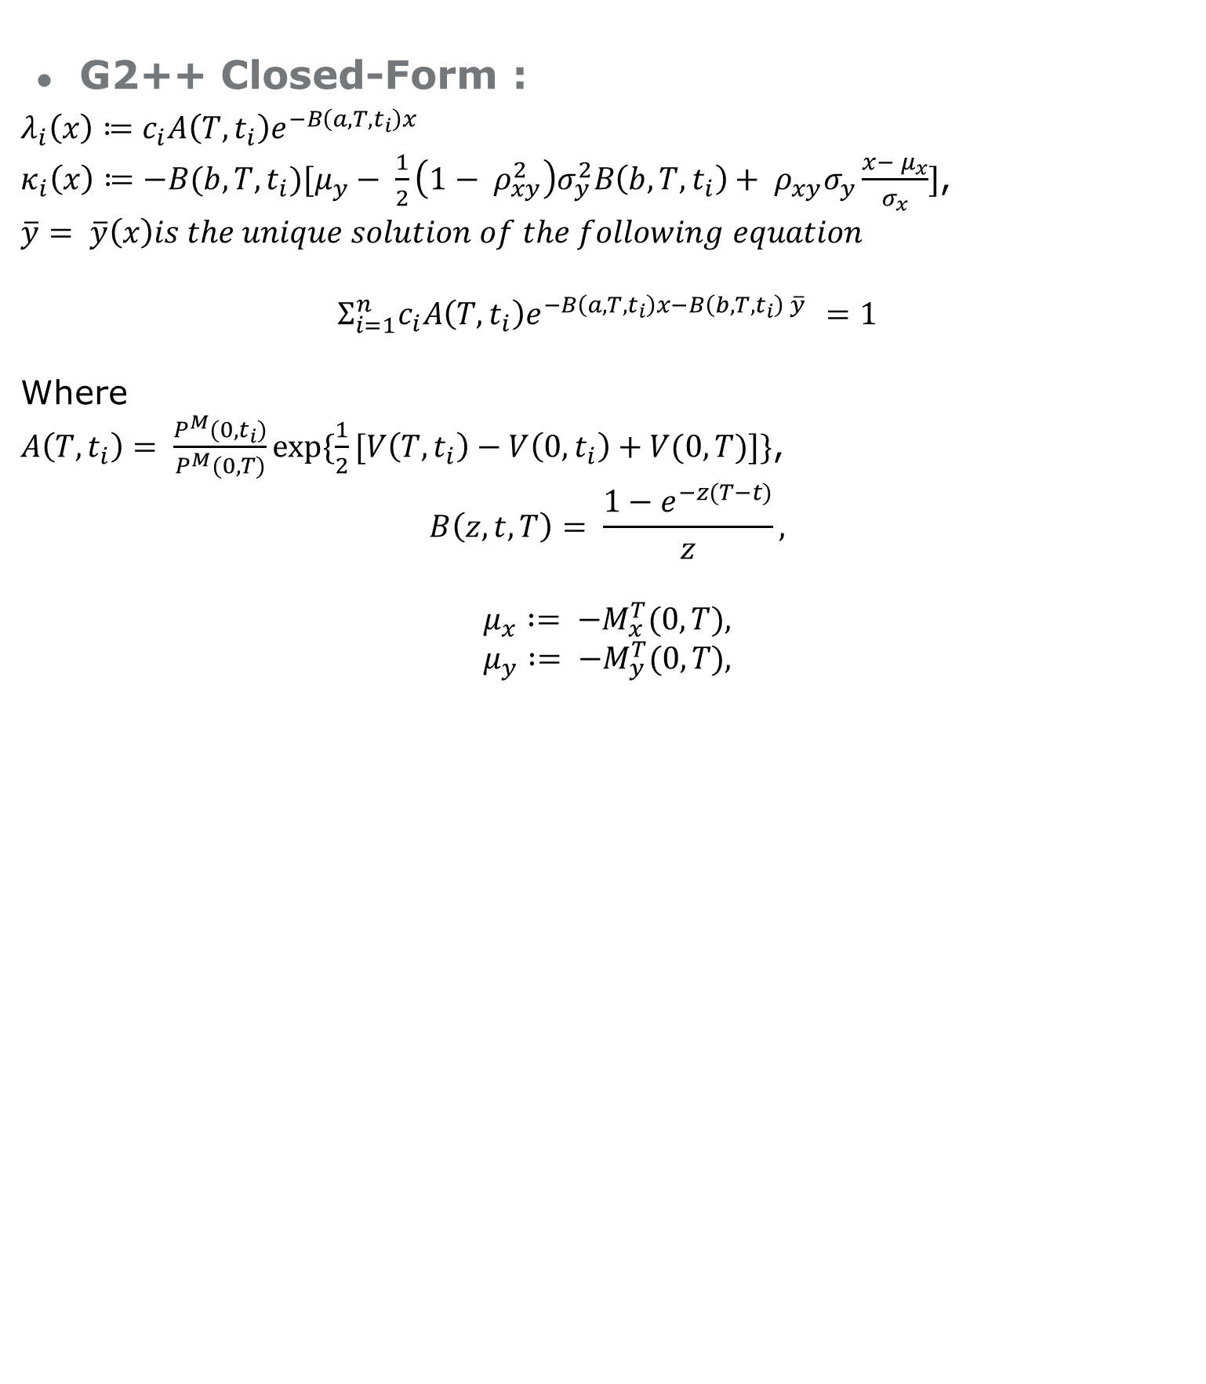
Appendix
G2++ Closed-Form :
$$λ_{i}\left(x\right)≔c_{i}A\left(T, t_{i}\right)e^{−B\left(a,T,t_{i}\right)x}$$
$κ_{i}\left(x\right)≔−B(b, T,t_{i})[μ_{y}− \frac{1}{2}\left(1− ρ_{xy}^{2}\right)σ_{y}^{2}B\left(b, T,t_{i}\right)+ ρ_{xy}σ_{y}\frac{x− μ_{x}}{σ_{x}}]$,
$$\overline{y}= \overline{y}\left(x\right)is the unique solution of the following equation$$
$$Σ_{i=1}^{n}c_{i}A\left(T, t_{i}\right)e^{−B\left(a,T,t_{i}\right)x−B\left(b,T,t_{i}\right) \overline{y} }=1$$
Where
$A\left(T, t_{i}\right)= \frac{P^{M}(0, t_{i})}{P^{M}(0, T)}exp⁡\{\frac{1}{2}[V\left(T, t_{i}\right)−V\left(0, t_{i}\right)+V(0, T)]\}$,
$$B\left(z, t, T\right)= \frac{1−e^{−z(T−t)}}{z},$$
$$μ_{x} := −M_{x}^{T}(0, T),$$
$$μ_{y} := −M_{y}^{T}(0, T),$$

Slide 33
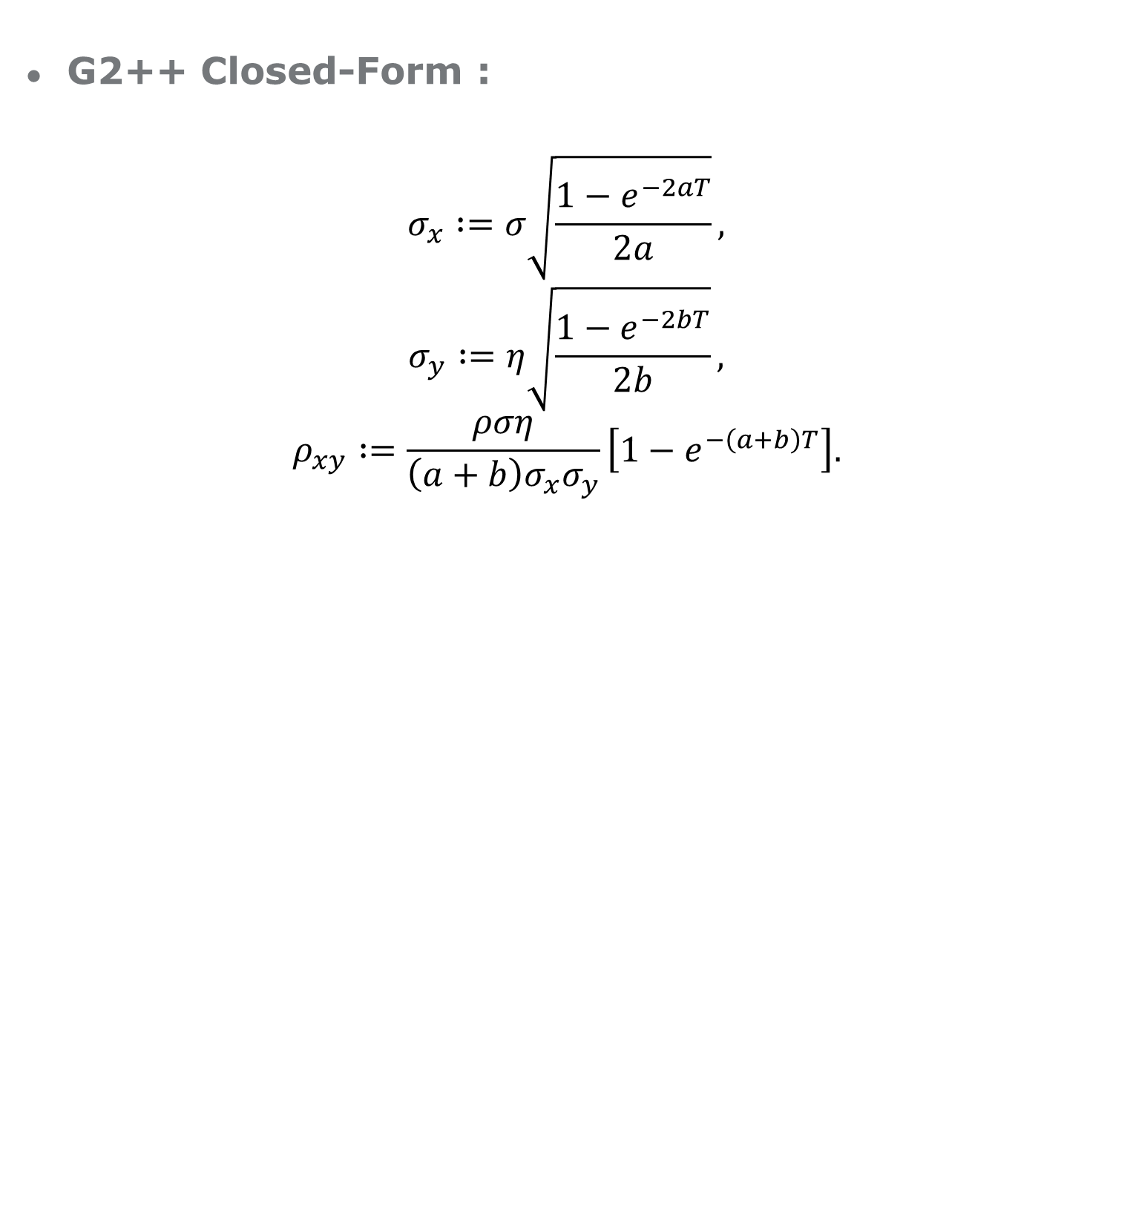
Appendix
G2++ Closed-Form :
$$σ_{x} :=σ\sqrt{\frac{1−e^{−2aT}}{2a}},$$
$$σ_{y} :=η\sqrt{\frac{1−e^{−2bT}}{2b}},$$
$$ρ_{xy} :=\frac{ρση}{\left(a+b\right)σ_{x}σ_{y}}\left[1−e^{−\left(a+b\right)T}\right].$$

Slide 34

Appendix
G2++ Closed-Form :
And
$$M_{x}^{T}\left(s, t\right)=\left(\frac{σ^{2}}{a^{2}}+ρ\frac{ση}{ab}\right)\left[1−e^{−a\left(t−s\right)}\right]− \frac{σ^{2}}{2a^{2}}\left[e^{−a\left(T−t\right)}−e^{−a\left(T+t−2s\right)}\right]− \frac{ρση}{b\left(a+b\right)}[e^{−b\left(T−t\right)}−e^{−bT−at+(a+b)s}],$$
$$M_{y}^{T}\left(s, t\right)=\left(\frac{η^{2}}{b^{2}}+ρ\frac{ση}{ab}\right)\left[1−e^{−b\left(t−s\right)}\right]−\frac{η^{2}}{2b^{2}}\left[e^{−b\left(T−t\right)}−e^{−b\left(T+t−2s\right)}\right]− \frac{ρση}{a\left(a+b\right)}[e^{−a\left(T−t\right)}−e^{−aT−bt+(a+b)s}] ,$$

Slide 35
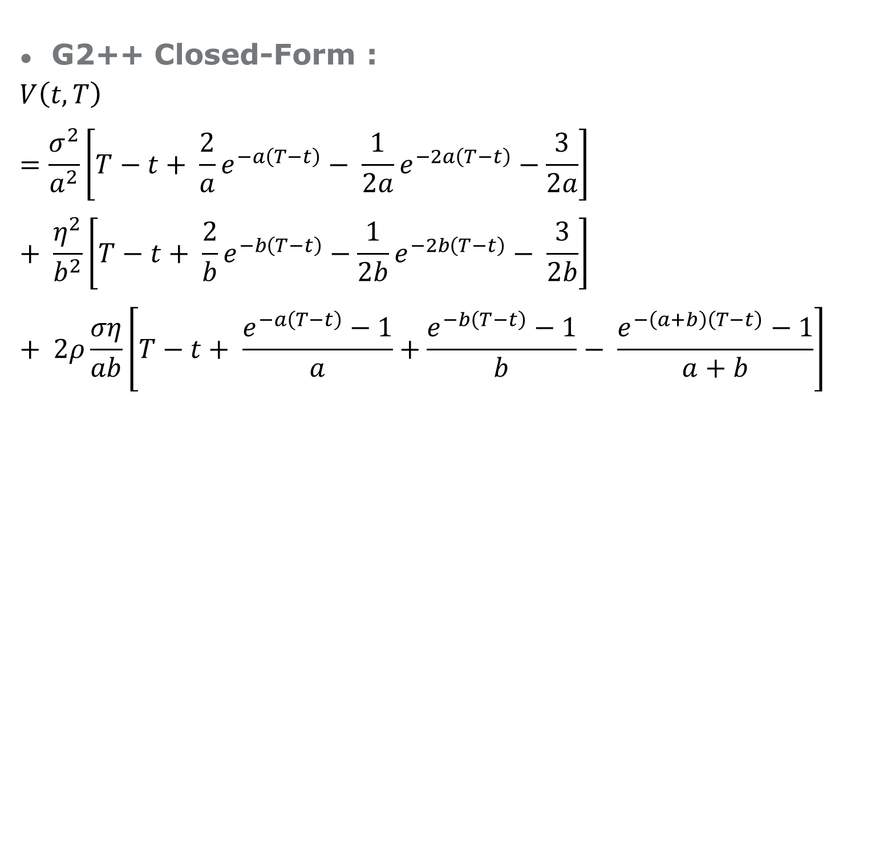
Appendix
G2++ Closed-Form :
$$V\left(t, T\right)=\frac{σ^{2}}{a^{2}}\left[T−t+ \frac{2}{a}e^{−a\left(T−t\right)}− \frac{1}{2a}e^{−2a\left(T−t\right)}−\frac{3}{2a}\right]+ \frac{η^{2}}{b^{2}}\left[T−t+ \frac{2}{b}e^{−b\left(T−t\right)}−\frac{1}{2b}e^{−2b\left(T−t\right)}− \frac{3}{2b}\right]+ 2ρ\frac{ση}{ab}\left[T−t+ \frac{e^{−a\left(T−t\right)}−1}{a}+\frac{e^{−b\left(T−t\right)}−1}{b}− \frac{e^{−\left(a+b\right)\left(T−t\right)}−1}{a+b}\right]$$

